Slide 1
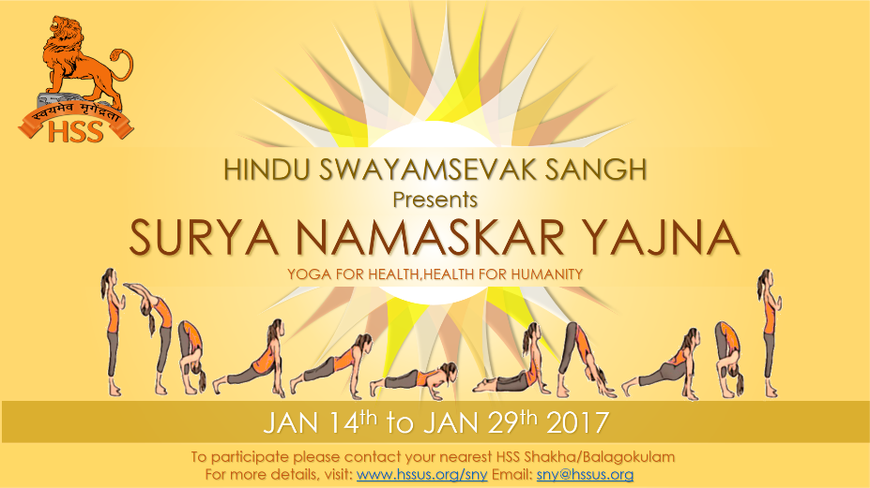
JAN 13 TO JAN 28TH 2018

Slide 2
Agenda
Surya Namaskar Yajna – An Introduction
Hinduism And Surya Namaskar
HSS Promoting Surya Namaskar
SNY achievement
How to participate
Benefits of Surya Namaskar
Postures And It’s Benefits

Slide 3
Agenda
Surya Namaskar Yajna – An Introduction
Hinduism And Surya Namaskar
HSS Promoting Surya Namaskar
SNY achievement
How to participate
Postures And It’s Benefits
Contacts

Slide 4
Surya Namaskar Yajna – An Introduction
"Yoga for Health, Health for Humanity Yogathon" or "Surya Namaskar Yajna“, an initiative by Hindu SwayamSevek Sangh starting in 2006
The 16-day event aims to create awareness about Yoga and its advantages in achieving a healthy body, mind and spirit.
Surya Namaskar integrates simple Yoga postures in 10-steps that, along with easy breathing technique, can provide immense health benefits to both the body and the mind.
Notes:
Hindu Swayamsevak Sangh USA (HSS) announces the tenth annual "Yoga for Health, Health for Humanity Yogathon" or "Surya Namaskar Yajna". The 16-day event aims to create awareness about Yoga and its advantages in achieving a healthy body, mind and spirit. Surya Namaskar integrates simple Yoga postures in 10-steps that, along with easy breathing technique, can provide immense health benefits to both the body and the mind.

Slide 5
Agenda
Surya Namaskar Yajna – An Introduction
Hinduism And Surya Namaskar
HSS Promoting Surya Namaskar
SNY achievement
How to participate
Postures And It’s Benefits
Contacts

Slide 6
Hinduism And Surya Namaskar
Each year Hindus worldwide celebrate January 14th as Makar Sankranti
It’s a day that marks the change of season as the sun enters the sign of Capricorn or Makar.
Makar Sankranti ushers in longer days; thus, the festivity symbolizes sunshine in life.
To mark this occasion, HSS has organized the "Yoga for Health, Health for Humanity" Yogathon from January 13th to January 28th 2018.
Notes:
Each year Hindus worldwide celebrate January 14th as Makar Sankranti – a day that marks the change of season as the sun enters the sign of Capricorn or Makar. Makar Sankranti ushers in longer days; thus, the festivity symbolizes sunshine in life. To mark this occasion, HSS has organized the "Yoga for Health, Health for Humanity" Yogathon from January 14th to January 29th 2017.
HSS initiated this health awareness project in 2006. Since its inception, participants from 40 states actively took part via various Yoga Centers, community organizations, schools and colleges regardless of individual faiths and beliefs, have participated and collectively performed over 4 million Surya Namaskars. Community leaders and many elected officials across the nation have appreciated this initiative and encouraged their residents to participate and gain the benefits of an overall healthy life style.
This year also, HSS invites community groups, Yoga centers, students, and individuals to learn and participate in Health for Humanity Yogathon. This program is open to people of all ages, gender, and races. Details of this event, training resources, and advertising aids are available on this web site. For questions or suggestions, at email “sny@hssus.org” or 973-500-8HSS (8477)

Slide 7
Agenda
Surya Namaskar Yajna – An Introduction
Hinduism And Surya Namaskar
HSS Promoting Surya Namaskar
SNY achievement
How to participate
Postures And It’s Benefits
Contacts

Slide 8
HSS Promoting Surya Namaskar
HSS initiated this health awareness project in 2006.
Since its inception, participants from 40 states actively took part via
Various Yoga Centers,
community organizations,
schools and colleges
regardless of individual faiths and beliefs, have participated and collectively performed over 4 million Surya Namaskars.
Community leaders and many elected officials across the nation have appreciated this initiative and encouraged their residents to participate and gain the benefits of an overall healthy life style.
Notes:
HSS initiated this health awareness project in 2006. Since its inception, participants from 40 states actively took part via various Yoga Centers, community organizations, schools and colleges regardless of individual faiths and beliefs, have participated and collectively performed over 4 million Surya Namaskars. Community leaders and many elected officials across the nation have appreciated this initiative and encouraged their residents to participate and gain the benefits of an overall healthy life style.

Slide 9
Agenda
Surya Namaskar Yajna – An Introduction
Hinduism And Surya Namaskar
HSS Promoting Surya Namaskar
SNY achievement
How to participate
Postures And It’s Benefits
Contacts

Slide 10
Postures And It’s Benefits
Surya Namaskar is a sequence of 10 simple asanas (Yoga postures) performed gracefully
Surya Namaskar is a Sun Salutation that is traditionally performed at dawn facing towards the rising sun.
The routine helps develop all five personality levels : namely physical, prana, mental, intellectual, and spiritual.
“Helps individuals to lead a very healthy lifestyle with a profound sense of well-being.”
Notes:
HSS initiated this health awareness project in 2006. Since its inception, participants from 40 states actively took part via various Yoga Centers, community organizations, schools and colleges regardless of individual faiths and beliefs, have participated and collectively performed over 4 million Surya Namaskars. Community leaders and many elected officials across the nation have appreciated this initiative and encouraged their residents to participate and gain the benefits of an overall healthy life style.

Slide 11
Benefits of Surya Namaskar
A set of ten yoga postures provides good exercise to the whole body, calms the mind, and sharpens the intellect.
Complete exercise to all the muscles and joints of the body
Tones all the muscles of the body and reduces fat thereby helping to control obesity and metabolism of the body.
Strengthens the spine and abdominal muscle to control nervous system and activity of the internal organs.
Expands the rib-caze, increases the capacity of lungs making the breath smooth and easy.
Activates the glands and regulates the hormone.
Encourage the lymph drainage thereby increasing the immunity and resistance of the body.
Increases the circulation of whole body thereby acting as an excellent cardiac workout to enhance the blood circulation and warming up the body.
Increases concentration, memory, learning and focusing ability and vigilance.
Relaxing and rejuvenating, and tension, stress and anxiety melt away as you perform Surya Namaskar.
Excellent alternative to caffeine and other stimulants.
If you suffer from insomnia or sleep disturbances, you will find practicing Surya Namaskar aids in helping you fall asleep without the need for depressants.
Notes:
HSS initiated this health awareness project in 2006. Since its inception, participants from 40 states actively took part via various Yoga Centers, community organizations, schools and colleges regardless of individual faiths and beliefs, have participated and collectively performed over 4 million Surya Namaskars. Community leaders and many elected officials across the nation have appreciated this initiative and encouraged their residents to participate and gain the benefits of an overall healthy life style.

Slide 12
Postures - Start
Siddha (Pranamasan)
Step 1: Urdhvasan (Inhale)
Step 2: Uttanasan (Exhale)
Step 3: Ek Pad Prasarasan (Inhale)
Step 4: Chaturang Dandasan (Exhale)
Step 5: Sashtang Pranipatasan (Retain)
Step 6: Urdhvamukh Shwanasan (Inhale)
Step 7: Adhomukh Shwanasan (Exhale)
Step 8 : Ek Pad Prasarasan (Inhale)
Step 9: Uttanasan (Exhale)
Step 10 :Siddha (Pranamasan)
Stand erect with feet touch fully each other. Chest out shoulder back and pressed below, neck straight.
Palms together touching each other in front of chest, fingers perpendicular to ground, thumbs touching to chest.
Fore-arms in line, parallel to the ground.
Siddha (Pranamasan)
Benefit : Good for the diseases of the throat. Voice is enhanced. Both mind and body become healthy.
Notes:
Run with F5 to see the animation

Slide 13
Postures – Step 1
Siddha (Pranamasan)
Step 1: Urdhvasan (Inhale)
Step 2: Uttanasan (Exhale)
Step 3: Ek Pad Prasarasan (Inhale)
Step 4: Chaturang Dandasan (Exhale)
Step 5: Sashtang Pranipatasan (Retain)
Step 6: Urdhvamukh Shwanasan (Inhale)
Step 7: Adhomukh Shwanasan (Exhale)
Step 8 : Ek Pad Prasarasan (Inhale)
Step 9: Uttanasan (Exhale)
Step 10 :Siddha (Pranamasan)
Palms engaged upward together in Namesake Mudra, Pointing towards the sky i.e. “Nabho Vadan”
Arms and legs straightend and Head will bent backwards.
Eyes fixed on wrists i.e. :Karamula”
Spine bent backwards and body above the trunk in graceful curved arch.
Step 1: Urdhvasan (Inhale)
Benefits : Both the shoulders and the food pipe (Esophagus) get exercise and diseases related to them are corrected. Eyesight is also improved
Notes:
Run with F5 to see the animation

Slide 14
Postures – Step 2
Siddha (Pranamasan)
Step 1: Urdhvasan (Inhale)
Step 2: Uttanasan (Exhale)
Step 3: Ek Pad Prasarasan (Inhale)
Step 4: Chaturang Dandasan (Exhale)
Step 5: Sashtang Pranipatasan (Retain)
Step 6: Urdhvamukh Shwanasan (Inhale)
Step 7: Adhomukh Shwanasan (Exhale)
Step 8 : Ek Pad Prasarasan (Inhale)
Step 9: Uttanasan (Exhale)
Step 10 :Siddha (Pranamasan)
Hand downwards in motion without bending in elbows.
Palm flat on the ground, just by the side of each foot.
Distance between palm equal to that of shoulders.
Big toes and palm in the line from front and straightened your legs.
Chins touches the chest and Forehead touching the knees.
Step 2: Uttanasan (Exhale)
Benefits : Disorders of the belly and digestive system are corrected. The chest and hands become stronger and you become well balanced, beautiful and good looking. Diseases of the feet and fingers are also corrected.
Notes:
Run with F5 to see the animation

Slide 15
Postures – Step 3
Siddha (Pranamasan)
Step 1: Urdhvasan (Inhale)
Step 2: Uttanasan (Exhale)
Step 3: Ek Pad Prasarasan (Inhale)
Step 4: Chaturang Dandasan (Exhale)
Step 5: Sashtang Pranipatasan (Retain)
Step 6: Urdhvamukh Shwanasan (Inhale)
Step 7: Adhomukh Shwanasan (Exhale)
Step 8 : Ek Pad Prasarasan (Inhale)
Step 9: Uttanasan (Exhale)
Step 10 :Siddha (Pranamasan)
Hand downwards in motion without bending in elbows.
Palm flat on the ground, just by the side of each foot.
Distance between palm equal to that of shoulders.
Big toes and palm in the line from front and straightened your legs.
Chins touches the chest and Forehead touching the knees.
Step 3: Ek Pad Prasarasan (Inhale)
Benefits : The posture stretches the small intestine and the seminal vesicles. Hence this posture helps in correcting the constipation and diseases of the liver. Thinness of the semen is also corrected. Diseases of the throat are also corrected.
Notes:
Run with F5 to see the animation

Slide 16
Postures – Step 4
Siddha (Pranamasan)
Step 1: Urdhvasan (Inhale)
Step 2: Uttanasan (Exhale)
Step 3: Ek Pad Prasarasan (Inhale)
Step 4: Chaturang Dandasan (Exhale)
Step 5: Sashtang Pranipatasan (Retain)
Step 6: Urdhvamukh Shwanasan (Inhale)
Step 7: Adhomukh Shwanasan (Exhale)
Step 8 : Ek Pad Prasarasan (Inhale)
Step 9: Uttanasan (Exhale)
Step 10 :Siddha (Pranamasan)
Right leg stretched back without moving both hands from their places.
Legs and arms straight, knees and elbow straightened.
Entire body in straight line from head to heel, supported on fix palms and toes only.
Eyes fixed on the ground, at right angle to the body.
Feet touching each other.
Step 4: Chaturang Dandasan (Exhale)
Benefits : One gets relief from the pains - specially of arms, legs and the knees. Bulging waist is trimmed and it is good for the abdominal disorders.
Notes:
Run with F5 to see the animation

Slide 17
Postures – Step 5
Siddha (Pranamasan)
Step 1: Urdhvasan (Inhale)
Step 2: Uttanasan (Exhale)
Step 3: Ek Pad Prasarasan (Inhale)
Step 4: Chaturang Dandasan (Exhale)
Step 5: Sashtang Pranipatasan (Retain)
Step 6: Urdhvamukh Shwanasan (Inhale)
Step 7: Adhomukh Shwanasan (Exhale)
Step 8 : Ek Pad Prasarasan (Inhale)
Step 9: Uttanasan (Exhale)
Step 10 :Siddha (Pranamasan)
Arms bent at elbow, without moving both the palms and Toes.
Forehead ,chest and knees simultaneously touching the ground, together with the palm and toes.
Chin pressed on the chest, Nose and pelvic region elevated
Both elbows drawn towards each other
Step 5: Sashtang Pranipatasan (Retain)
Benefits :This posture makes the arms strong. If ladies perform this Asana before getting pregnant, the breast fed babies could be saved from the attacks of many diseases.
Notes:
Run with F5 to see the animation

Slide 18
Postures – Step 6
Siddha (Pranamasan)
Step 1: Urdhvasan (Inhale)
Step 2: Uttanasan (Exhale)
Step 3: Ek Pad Prasarasan (Inhale)
Step 4: Chaturang Dandasan (Exhale)
Step 5: Sashtang Pranipatasan (Retain)
Step 6: Urdhvamukh Shwanasan (Inhale)
Step 7: Adhomukh Shwanasan (Exhale)
Step 8 : Ek Pad Prasarasan (Inhale)
Step 9: Uttanasan (Exhale)
Step 10 :Siddha (Pranamasan)
Arms straight, elbows straightened and chest pushed out.
Waist pull towards the centre, between palms.
Spine fully arched, Eyes towards the sky and Shoulder and head thrown back.
Knees touching the ground, feet together, toes firm
Step 6: Urdhvamukh Shwanasan (Inhale)
Benefits : Tones up the body and the back muscles and improves the eyesight. Corrects all kinds of disorders related to the reproductive system, corrects the irregularities in females menstrual cycles. Blood circulation is also improved.
Notes:
Run with F5 to see the animation

Slide 19
Postures – Step 7
Siddha (Pranamasan)
Step 1: Urdhvasan (Inhale)
Step 2: Uttanasan (Exhale)
Step 3: Ek Pad Prasarasan (Inhale)
Step 4: Chaturang Dandasan (Exhale)
Step 5: Sashtang Pranipatasan (Retain)
Step 6: Urdhvamukh Shwanasan (Inhale)
Step 7: Adhomukh Shwanasan (Exhale)
Step 8 : Ek Pad Prasarasan (Inhale)
Step 9: Uttanasan (Exhale)
Step 10 :Siddha (Pranamasan)
Without shifting the palms and the toes from the ground, the torso is raised upwards.
Both heels touching the ground.
Heels, waist and wrist form a triangle.
Head pulled towards knees, Chin touched to chest
Eyes centered on nose-tip
Step 7: Adhomukh Shwanasan (Exhale)
Benefits : One gets relief from the pains - specially of arms, legs and the knees. Bulging waist is trimmed and it is good for the abdominal disorders.
Notes:
Run with F5 to see the animation

Slide 20
Postures – Step 8
Siddha (Pranamasan)
Step 1: Urdhvasan (Inhale)
Step 2: Uttanasan (Exhale)
Step 3: Ek Pad Prasarasan (Inhale)
Step 4: Chaturang Dandasan (Exhale)
Step 5: Sashtang Pranipatasan (Retain)
Step 6: Urdhvamukh Shwanasan (Inhale)
Step 7: Adhomukh Shwanasan (Exhale)
Step 8 : Ek Pad Prasarasan (Inhale)
Step 9: Uttanasan (Exhale)
Step 10 :Siddha (Pranamasan)
Left knee forward, folded in knee, foot resting between palms on its original place.
Right knee and toe touches the ground.
Rest of the body as it was in third position.
In order balance movement of legs, they should alternate changed in each Surya Namaskar
Step 8 : Ek Pad Prasarasan (Inhale)
Benefits : The posture stretches the small intestine and the seminal vesicles. Hence this posture helps in correcting the constipation and diseases of the liver. Thinness of the semen is also corrected. Diseases of the throat are also corrected.
Notes:
Run with F5 to see the animation

Slide 21
Postures – Step 9
Siddha (Pranamasan)
Step 1: Urdhvasan (Inhale)
Step 2: Uttanasan (Exhale)
Step 3: Ek Pad Prasarasan (Inhale)
Step 4: Chaturang Dandasan (Exhale)
Step 5: Sashtang Pranipatasan (Retain)
Step 6: Urdhvamukh Shwanasan (Inhale)
Step 7: Adhomukh Shwanasan (Exhale)
Step 8 : Ek Pad Prasarasan (Inhale)
Step 9: Uttanasan (Exhale)
Step 10 :Siddha (Pranamasan)
Keeping palms fixed on the ground, bring right foot forward in original place aligned with left leg.
Big toes and heel touching each other, i.e. “Sama Carana”
Legs and Arms Straight, Knees and elbow straightened,
Chin touching chest and Forehead touching the knees.
Body vertically well balanced.
Step 9: Uttanasan (Exhale)
Benefits : Disorders of the belly and digestive system are corrected. The chest and hands become stronger and you become well balanced, beautiful and good looking. Diseases of the feet and fingers are also corrected.
Notes:
Run with F5 to see the animation

Slide 22
Postures – Step 10
Siddha (Pranamasan)
Step 1: Urdhvasan (Inhale)
Step 2: Uttanasan (Exhale)
Step 3: Ek Pad Prasarasan (Inhale)
Step 4: Chaturang Dandasan (Exhale)
Step 5: Sashtang Pranipatasan (Retain)
Step 6: Urdhvamukh Shwanasan (Inhale)
Step 7: Adhomukh Shwanasan (Exhale)
Step 8 : Ek Pad Prasarasan (Inhale)
Step 9: Uttanasan (Exhale)
Step 10 :Siddha (Pranamasan)
Stand erect with feet touch fully each other. Chest out shoulder back and pressed below, neck straight.
Palms together touching each other in front of chest, fingers perpendicular to ground, thumbs touching to chest.
Step 10 :Siddha (Pranamasan)
Benefits : Good for the diseases of thethroat. Voice is enhanced. Both mindand body become healthy.
Notes:
Run with F5 to see the animation

Slide 23
Agenda
Surya Namaskar Yajna – An Introduction
Hinduism And Surya Namaskar
HSS Promoting Surya Namaskar
SNY achievement
How to participate
Postures And It’s Benefits
Contacts

Slide 24
SNY achievement
In last one decade
Reached out more than 120,000 people and still counting
Cumulative count of Surya Namaskar performed has crossed 9,000,000 (within 16 days period)
US-wide HSS has received more than 100’s of proclamation from various city official’s
Have collaborated with various school, Yoga studio’s, Office to host joint event related to SNY
Notes:
Surya Namaskar in a set of ten yoga postures provides good exercise to the whole body, calms the mind, and sharpens the intellect.
Surya namaskar energizes the entire neuroglandular and neuromuscular system of the body and its regular practice ensures a balanced supply of oxygenated blood and perfect harmony to all the systems of the body thus involves the entire psychosomatic system of human constitution.
Surya-namaskar is a complete exercise to all the muscles and joints of the body. It tones all the muscles of the body and reduces fat thereby helping to control obesity and metabolism of the body..
It strengthens the spine and abdominal muscle to control nervous system and activity of the internal organs.
It expands the rib-caze, increases the capacity of lungs making the breath smooth and easy.
it activates the glands and regulates the hormone.
It encourage the lymph drainage thereby increasing the immunity and resistance of the body.
It increases the circulation of whole body thereby acting as an excellent cardiac workout to enhance the blood circulation and warming up the body.
It increases concentration, memory, learning and focusing ability and vigilance.
It is relaxing and rejuvenating, and tension, stress and anxiety melt away as you perform Surya Namaskar.
Surya Namaskar practice stimulates and conditions virtually every system in the body. It is good for the heart and stimulates the cardiovascular system. It oxygenates the blood and helps strengthen the heart. Surya Namaskar is good for the digestive system and the nervous system. It stimulates the lymphatic system and supports respiratory system health, as well.
Surya Namaskar is an excellent alternative to caffeine and other stimulants. If you suffer from insomnia or sleep disturbances, you will find practicing Surya Namaskar aids in helping you fall asleep without the need for depressants.

Slide 25
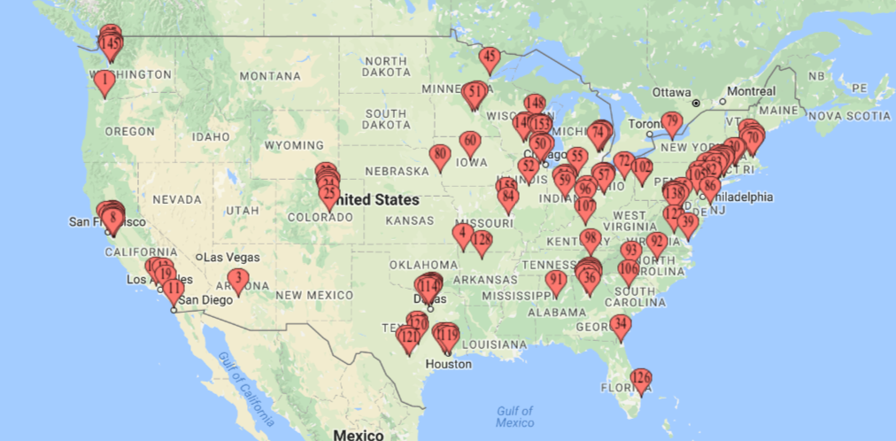
SNY achievement
In last one decade SNY has reached out to
40 States 169 Cities
Notes:
Surya Namaskar in a set of ten yoga postures provides good exercise to the whole body, calms the mind, and sharpens the intellect.
Surya namaskar energizes the entire neuroglandular and neuromuscular system of the body and its regular practice ensures a balanced supply of oxygenated blood and perfect harmony to all the systems of the body thus involves the entire psychosomatic system of human constitution.
Surya-namaskar is a complete exercise to all the muscles and joints of the body. It tones all the muscles of the body and reduces fat thereby helping to control obesity and metabolism of the body..
It strengthens the spine and abdominal muscle to control nervous system and activity of the internal organs.
It expands the rib-caze, increases the capacity of lungs making the breath smooth and easy.
it activates the glands and regulates the hormone.
It encourage the lymph drainage thereby increasing the immunity and resistance of the body.
It increases the circulation of whole body thereby acting as an excellent cardiac workout to enhance the blood circulation and warming up the body.
It increases concentration, memory, learning and focusing ability and vigilance.
It is relaxing and rejuvenating, and tension, stress and anxiety melt away as you perform Surya Namaskar.
Surya Namaskar practice stimulates and conditions virtually every system in the body. It is good for the heart and stimulates the cardiovascular system. It oxygenates the blood and helps strengthen the heart. Surya Namaskar is good for the digestive system and the nervous system. It stimulates the lymphatic system and supports respiratory system health, as well.
Surya Namaskar is an excellent alternative to caffeine and other stimulants. If you suffer from insomnia or sleep disturbances, you will find practicing Surya Namaskar aids in helping you fall asleep without the need for depressants.

Slide 26
Agenda
Surya Namaskar Yajna – An Introduction
Hinduism And Surya Namaskar
HSS Promoting Surya Namaskar
SNY achievement
How to participate
Postures And It’s Benefits
Contacts

Slide 27
How to participate
Two simple step to be the part healthy moment
Visit our local chapter (Shaka/Balagokulam) near you during this period and perform along with big group.
Or
Practice Surya Namaskar everyday at your home, Office, social gathering to promote the message of health for humanity
Keep the track of count and report to local chapter (Shakha/Balagokulam) coordinator
or
Download Surya Namaskar yajna from Android or IOS app store and report the count
Continue to do it even after the yajna. Do it everyday the rest of your life, and experience the wonders.
Step 1: Practice Surya Namaskar
Step 2: Report the counts
Notes:
Surya Namaskar in a set of ten yoga postures provides good exercise to the whole body, calms the mind, and sharpens the intellect.
Surya namaskar energizes the entire neuroglandular and neuromuscular system of the body and its regular practice ensures a balanced supply of oxygenated blood and perfect harmony to all the systems of the body thus involves the entire psychosomatic system of human constitution.
Surya-namaskar is a complete exercise to all the muscles and joints of the body. It tones all the muscles of the body and reduces fat thereby helping to control obesity and metabolism of the body..
It strengthens the spine and abdominal muscle to control nervous system and activity of the internal organs.
It expands the rib-caze, increases the capacity of lungs making the breath smooth and easy.
it activates the glands and regulates the hormone.
It encourage the lymph drainage thereby increasing the immunity and resistance of the body.
It increases the circulation of whole body thereby acting as an excellent cardiac workout to enhance the blood circulation and warming up the body.
It increases concentration, memory, learning and focusing ability and vigilance.
It is relaxing and rejuvenating, and tension, stress and anxiety melt away as you perform Surya Namaskar.
Surya Namaskar practice stimulates and conditions virtually every system in the body. It is good for the heart and stimulates the cardiovascular system. It oxygenates the blood and helps strengthen the heart. Surya Namaskar is good for the digestive system and the nervous system. It stimulates the lymphatic system and supports respiratory system health, as well.
Surya Namaskar is an excellent alternative to caffeine and other stimulants. If you suffer from insomnia or sleep disturbances, you will find practicing Surya Namaskar aids in helping you fall asleep without the need for depressants.

Slide 28
Agenda
Surya Namaskar Yajna – An Introduction
Hinduism And Surya Namaskar
HSS Promoting Surya Namaskar
SNY achievement
How to participate
Postures And It’s Benefits
Contacts

Slide 29
Contacts
Contact from Local Chapter
Contact 1 : Name | Contact 2 : Name
Phone # Email | Phone # Email
For Suggestions and Feed Back
Email us @ sny@hssus.org or Call @ 973-500-8HSS (8477)
www.hssus.org/sny
Notes:
Surya Namaskar in a set of ten yoga postures provides good exercise to the whole body, calms the mind, and sharpens the intellect.
Surya namaskar energizes the entire neuroglandular and neuromuscular system of the body and its regular practice ensures a balanced supply of oxygenated blood and perfect harmony to all the systems of the body thus involves the entire psychosomatic system of human constitution.
Surya-namaskar is a complete exercise to all the muscles and joints of the body. It tones all the muscles of the body and reduces fat thereby helping to control obesity and metabolism of the body..
It strengthens the spine and abdominal muscle to control nervous system and activity of the internal organs.
It expands the rib-caze, increases the capacity of lungs making the breath smooth and easy.
it activates the glands and regulates the hormone.
It encourage the lymph drainage thereby increasing the immunity and resistance of the body.
It increases the circulation of whole body thereby acting as an excellent cardiac workout to enhance the blood circulation and warming up the body.
It increases concentration, memory, learning and focusing ability and vigilance.
It is relaxing and rejuvenating, and tension, stress and anxiety melt away as you perform Surya Namaskar.
Surya Namaskar practice stimulates and conditions virtually every system in the body. It is good for the heart and stimulates the cardiovascular system. It oxygenates the blood and helps strengthen the heart. Surya Namaskar is good for the digestive system and the nervous system. It stimulates the lymphatic system and supports respiratory system health, as well.
Surya Namaskar is an excellent alternative to caffeine and other stimulants. If you suffer from insomnia or sleep disturbances, you will find practicing Surya Namaskar aids in helping you fall asleep without the need for depressants.

Slide 30
Notes:
This year also, HSS invites community groups, Yoga centers, students, and individuals to learn and participate in Health for Humanity Yogathon. This program is open to people of all ages, gender, and races. Details of this event, training resources, and advertising aids are available on this web site. For questions or suggestions, at email “sny@hssus.org” or 973-500-8HSS (8477)

