Slide 1
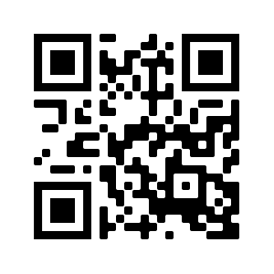
Hindu Swayamsevak Sangh
presents
Health for Humanity Yogathon 2021
January 16th – January 31st
Healthy families…
Healthy community!
Event date and time…
Contact info #1
Contact info #2
www.hssus.org/sny
www.facebook.com/hssus

